Slide 1

佰鸿净化产品CE认证和UL认证资料
好品质 佰鸿造
Hao pin zhi Bai hong Zao
CE and UL certification materials for Baihong purification products
东莞市佰鸿净化设备有限公司
Dongguan Baihong Purification Equipment Co., Ltd
地址：广东东莞市大朗镇石厦村金厦东路28号
Address: No. 28 Jinxia East Road, Shixia Village, Dalang Town, Dongguan City, Guangdong Province
服务热线：0769-81293773 邮箱：BH81293773@163.com 网址：www.baihong666.com
Service hotline: 0769-81293773 Email: BH81293773@163.com website: www.baihong666.com

Slide 2
目录
好品质 佰鸿造
Hao pin zhi Bai hong Zao
01
公司介绍
company introduction
02
风淋室CE认证合格书
Certificate of CE certification in air shower room
catalogue
03
货淋室CE认证合格书
Certificate of CE certification in cargo shower room
04
高效送风口CE认证合格书
Certificate of CE certification for efficient air supply outlet
05
风机UL认证
UL certification of fan
06
风淋室货淋室PLc控制器
Air shower room cargo shower room PLc controller
07
风淋室货淋室控制屏
Air shower room cargo shower room control screen

Slide 3
好品质 佰鸿造
Hao pin zhi Bai hong Zao
东莞市佰鸿净化设备有限公司，始终坚持走高质量发展道路，“好品质，佰鸿造”，上下一心把，快，准，狠，作为团队的行动指南，“效率第一，客户第一”为奋斗目标，十余年来专心致志不断创新与开拓空气净化设备领域。
Dongguan Baihong Purification Equipment Co., Ltd. has always adhered to the path of high-quality development, with "good quality, Baihong manufacturing" and a focus on "fast, accurate, and ruthless" as the team's action guide. The goal is "efficiency first, customer first". For more than ten years, we have been dedicated to innovating and exploring the field of air purification equipment.
公司拥有强大的专业与创新的技术研发和管理团队，高素质高技能的生产队伍，智能化先进生产设备，完善的售前、售中，售后的服务保障体系，公司荣获了高新技术企业，多款产品已通过了欧盟CE认证及第三方检测机构检测认证。
The company has a strong professional and innovative technology research and development and management team, a high-quality and highly skilled production team, intelligent advanced production equipment, and a comprehensive pre-sale, in sales, and after-sales service guarantee system. The company has been awarded the title of a high-tech enterprise, and multiple products have passed the European Union CE certification and third-party testing agency certification.
公司主营产品有：风淋室、货淋室、自动风/货淋室、PVC快速卷帘门风/货淋室、标准传递窗、风淋传递窗、洁净工作台、FFU送风单元、各种级别洁净棚、各种规格高效送风口，配套净化末端设备的耗材：初、中、高效过滤器、等等产品。
The company's main products include: air shower rooms, cargo shower rooms, automatic air/cargo shower rooms, PVC fast rolling shutter door air/cargo shower rooms, standard transfer windows, air shower transfer windows, clean workbenches, FFU air supply units, various levels of clean sheds, various specifications of high-efficiency air supply outlets, and consumables for supporting purification end equipment, such as primary, medium, and high-efficiency filters.
公司产品广泛运用于，新能源新材料，半导体微电子，航空航天，光电技术，光学仪器，生物制药，日用化工，汽车制造，精密五金，食品加工等，产品销往全国各地，远销中东及东南亚等国。
The company's products are widely used in new energy and new materials, semiconductor microelectronics, aerospace, optoelectronic technology, optical instruments, biopharmaceuticals, daily chemical industry, automotive manufacturing, precision hardware, food processing, etc. The products are sold throughout the country and exported to countries such as the Middle East and Southeast Asia.
公司成立以来，公司始终秉承；“以品牌为导向，以技术为核心，完善服务作后盾”为经营理念，在业内享有较高的盛誉，被多家大型头部百强企业品牌库选定为品牌供应商。
Since its establishment, the company has always adhered to; With the business philosophy of "brand oriented, technology at the core, and perfect service as the backing", it enjoys a high reputation in the industry and has been selected as a brand supplier by multiple large top 100 enterprise brand libraries.
佰鸿人始终不懈努力奋斗，为客户全心全意的服务，欢迎新老客户光临惠顾。
Baihong people always strive tirelessly and provide wholehearted service to customers. We welcome new and old customers to visit and patronize us.
01
公司简介
Company Introduction

Slide 4
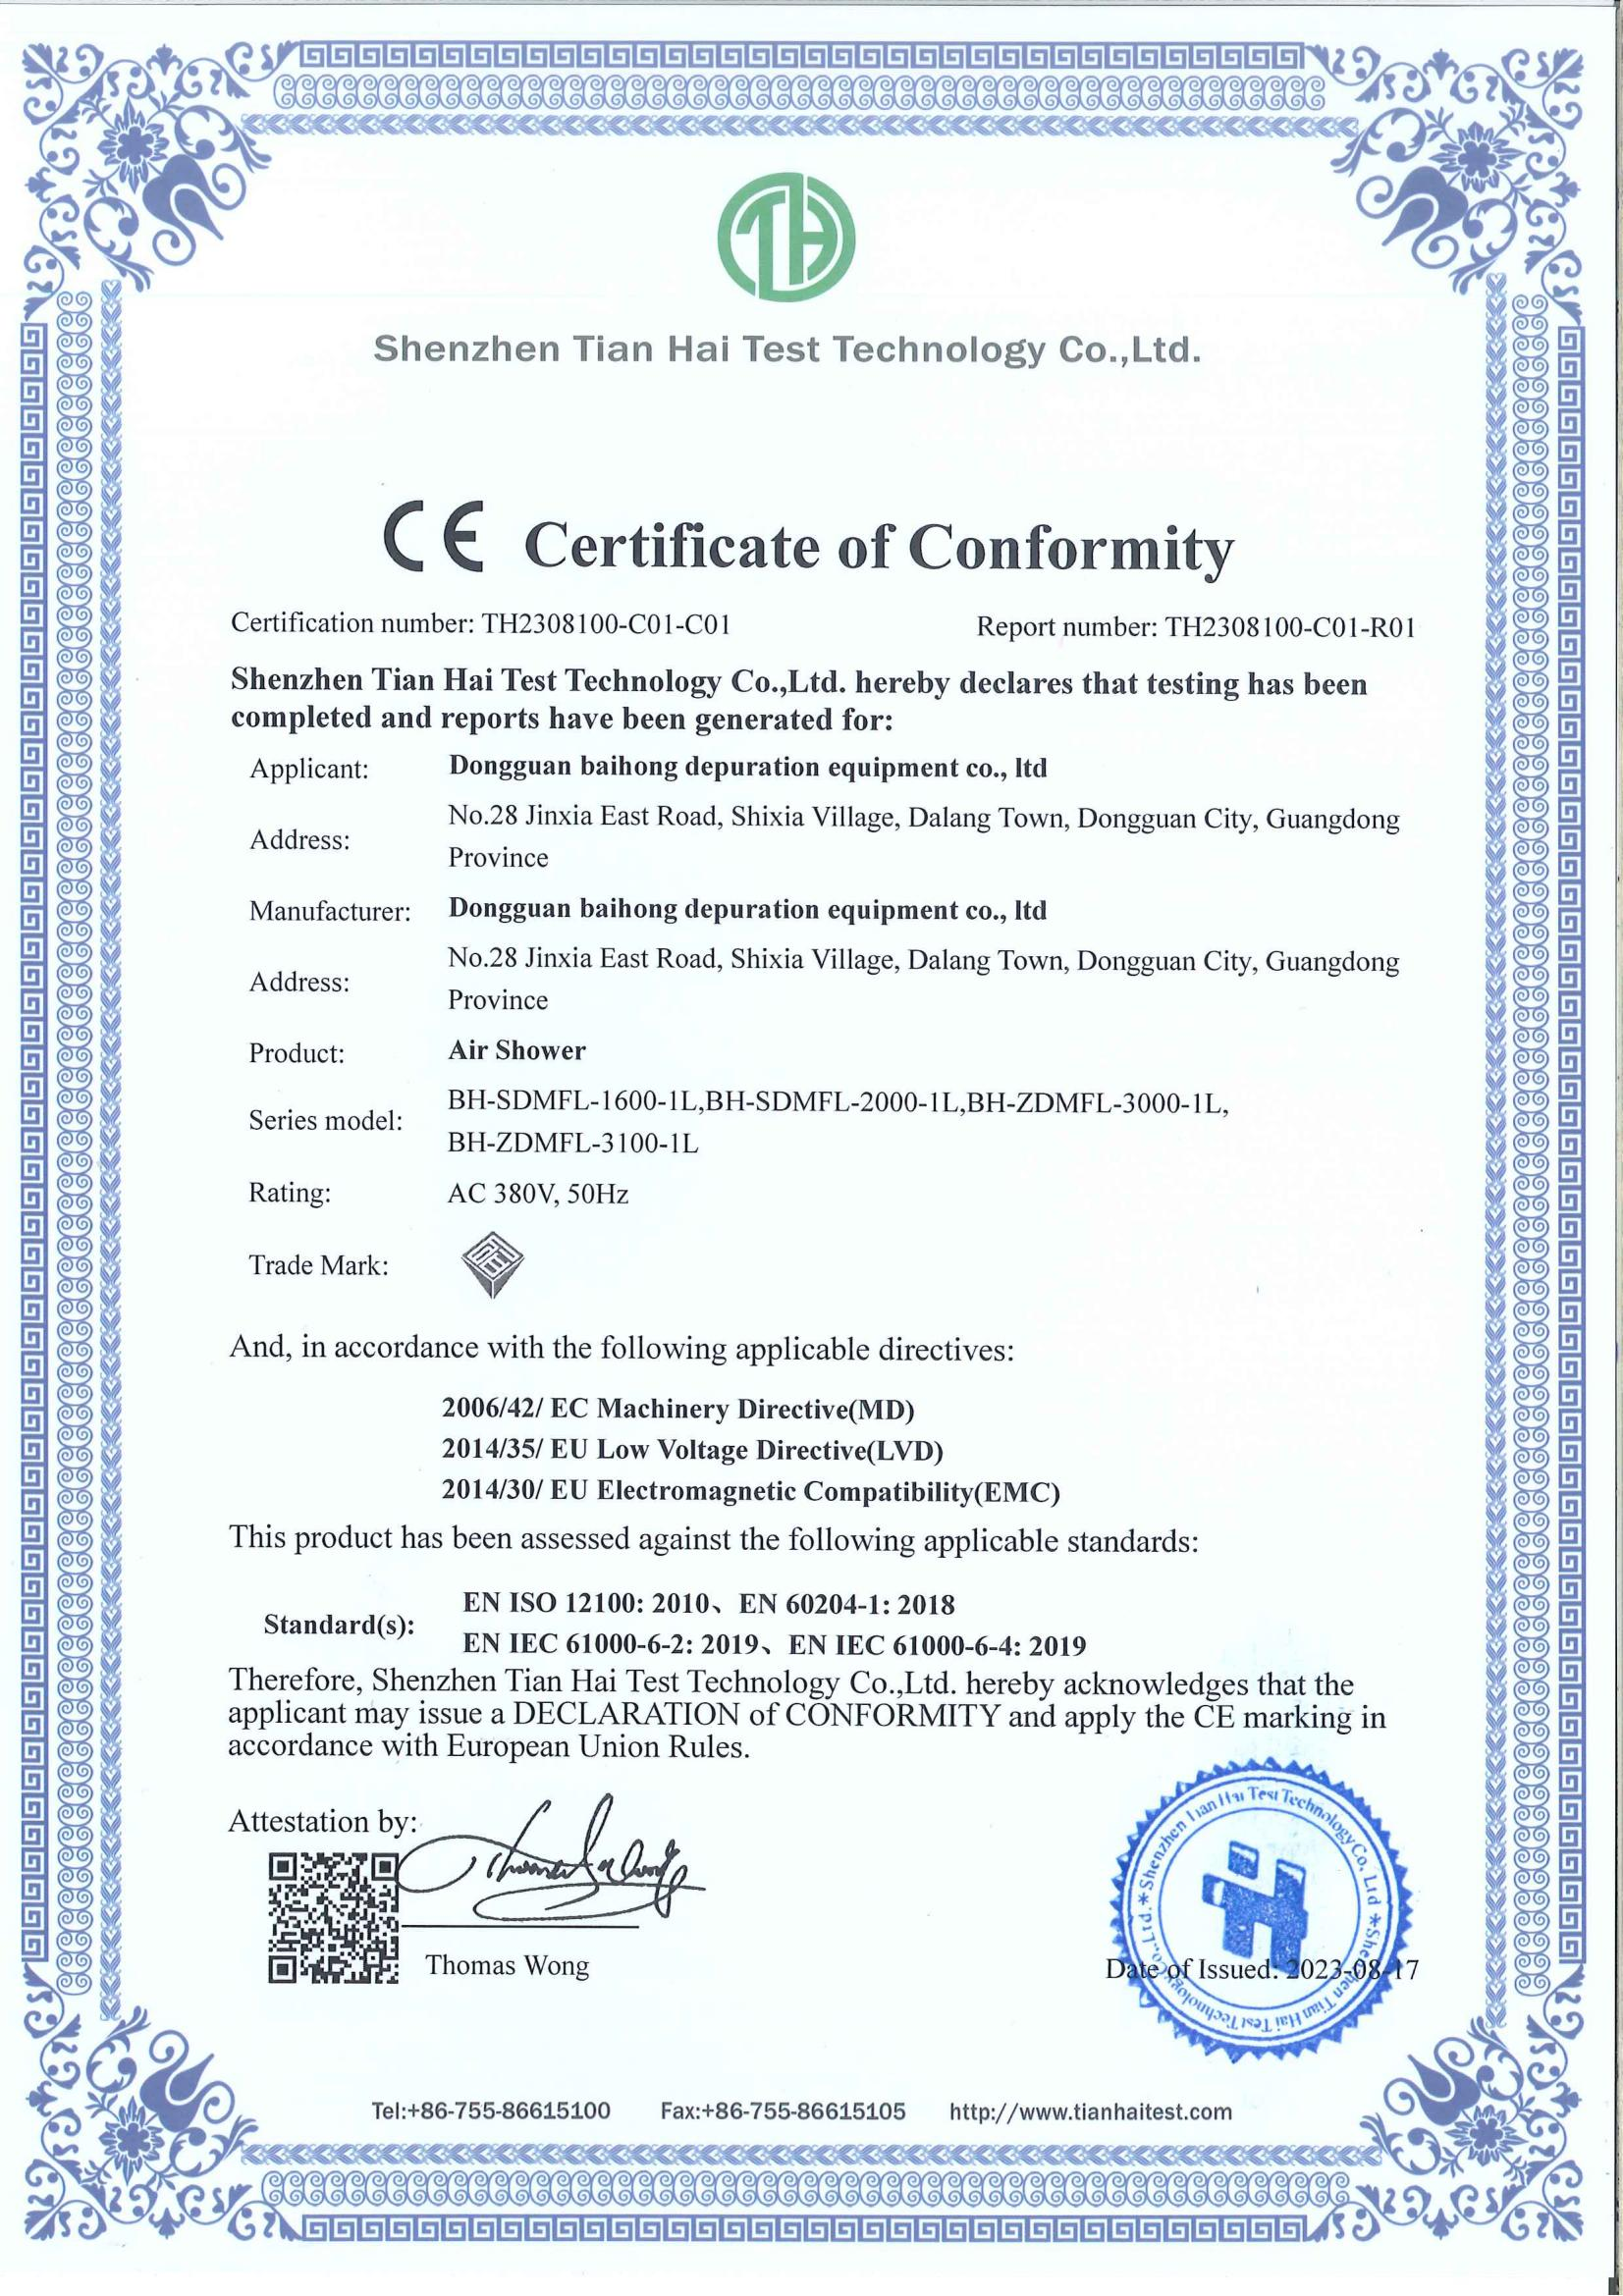
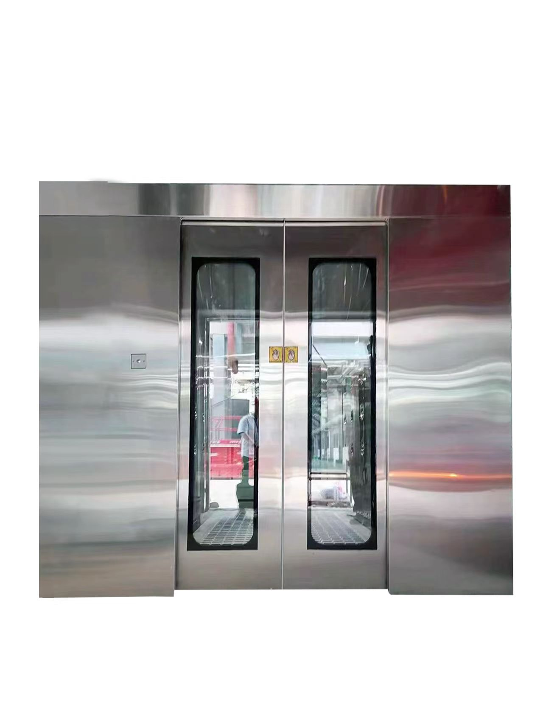
好品质 佰鸿造
Hao pin zhi Bai hong Zao
02
风淋室CE认证合格书
Certificate of CE certification in air shower room
型号：BH-SDMFL-1600-1L
外型尺寸：W1600*D1500*H2170
风淋尺寸：W1000*D1420*H2000
型号：BH-SDMFL-2000-1L
外型尺寸：W2000*D2500*H3400
风淋尺寸：W2600*D2600*H3500
型号：H-ZDMFL-3100-1L
外型尺寸：W3100*D2340*H2200
风淋尺寸：W1500*D2000*H2000
型号：BH-ZDMFL-3000-1L
外型尺寸：W1600*D3000*H2200
风淋尺寸：W1000*D3000*H2000

Slide 5
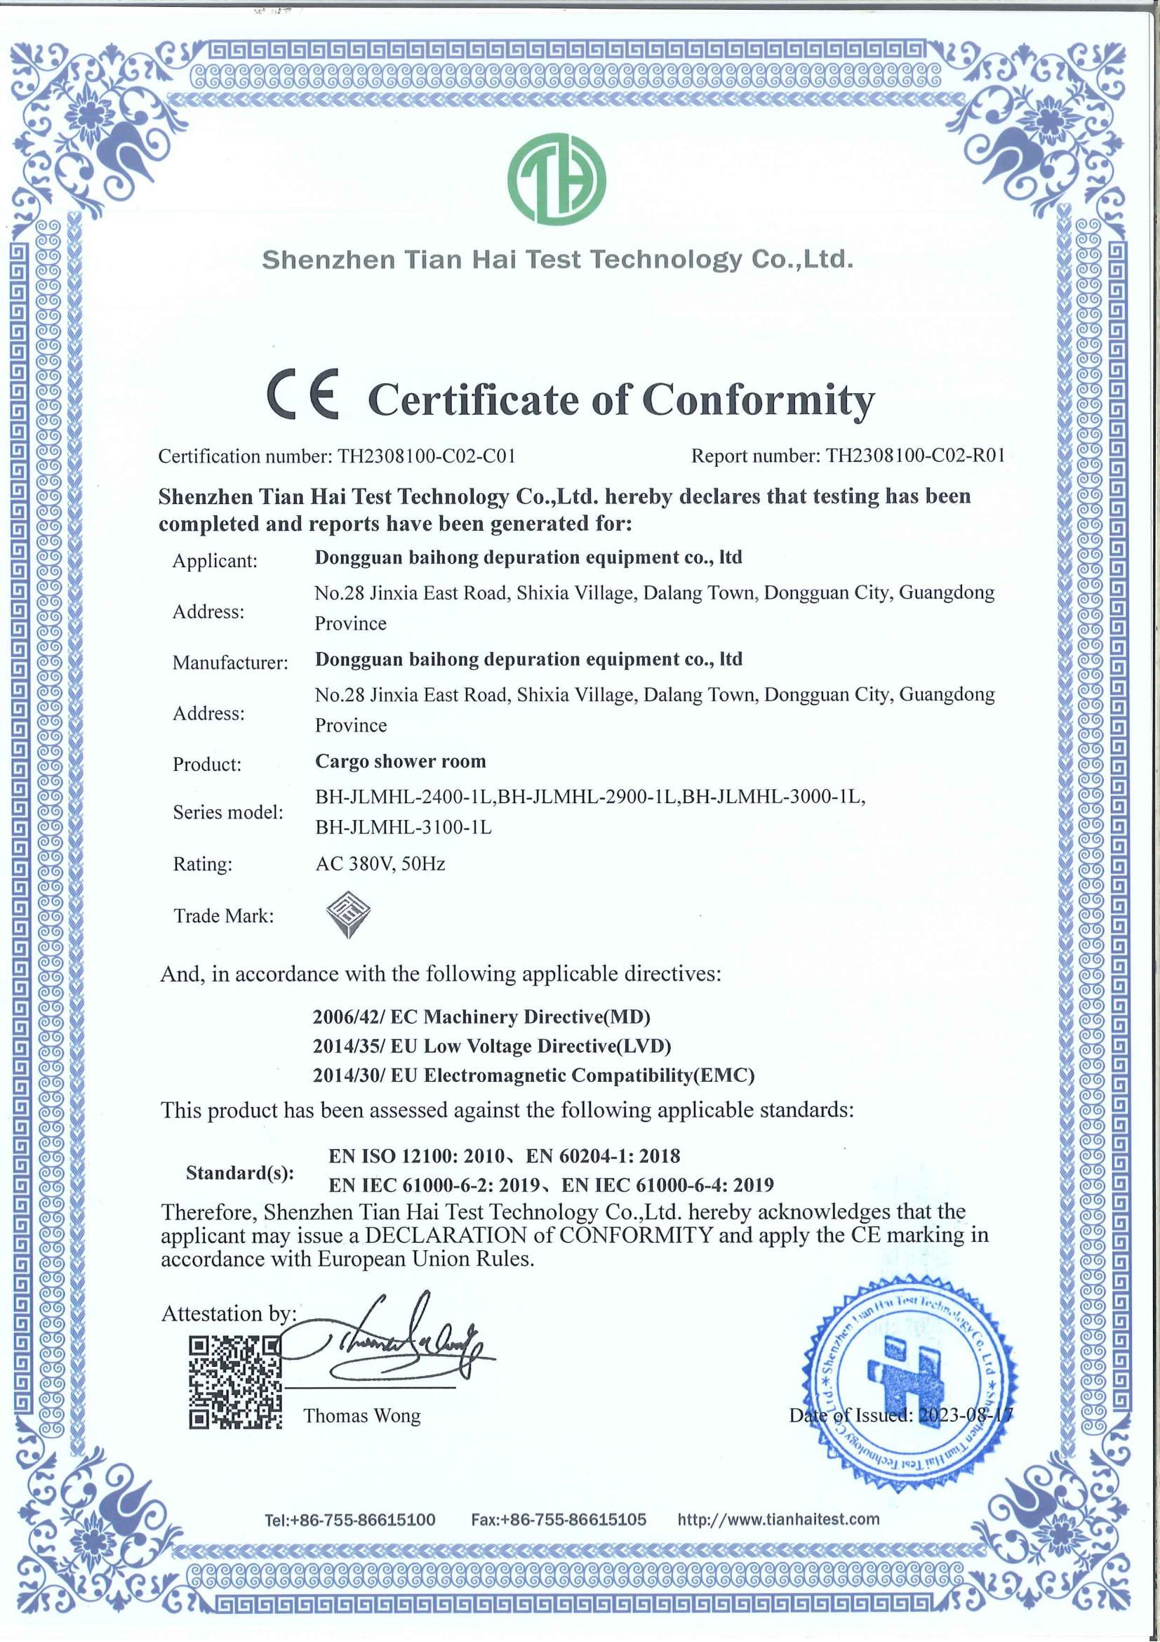
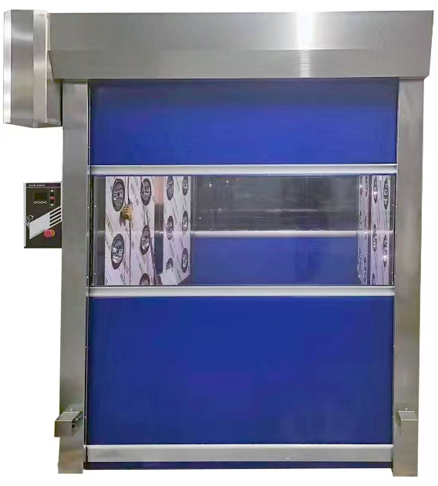
好品质 佰鸿造
Hao pin zhi Bai hong Zao
03
货淋室CE认证合格书
Certificate of CE certification in cargo shower room
型号：BH-JLMHL-2400-1L
外型尺寸：W2400*D3040*H2850
风淋尺寸：W1800*D2800*H2500
型号：BH-JLMHL-3100-1L
外型尺寸：W3100*D2740*H3350
风淋尺寸：W2500*D2500*H3000
型号：BH-JLMHL-2900-1L
外型尺寸：W2900*D2440*H2750
风淋尺寸：W1800*D2200*H2400
型号：BH-JLMHL-3000-1L
外型尺寸：W3000*D2640*H2750
风淋尺寸：W2400*D2400*H2400

Slide 6
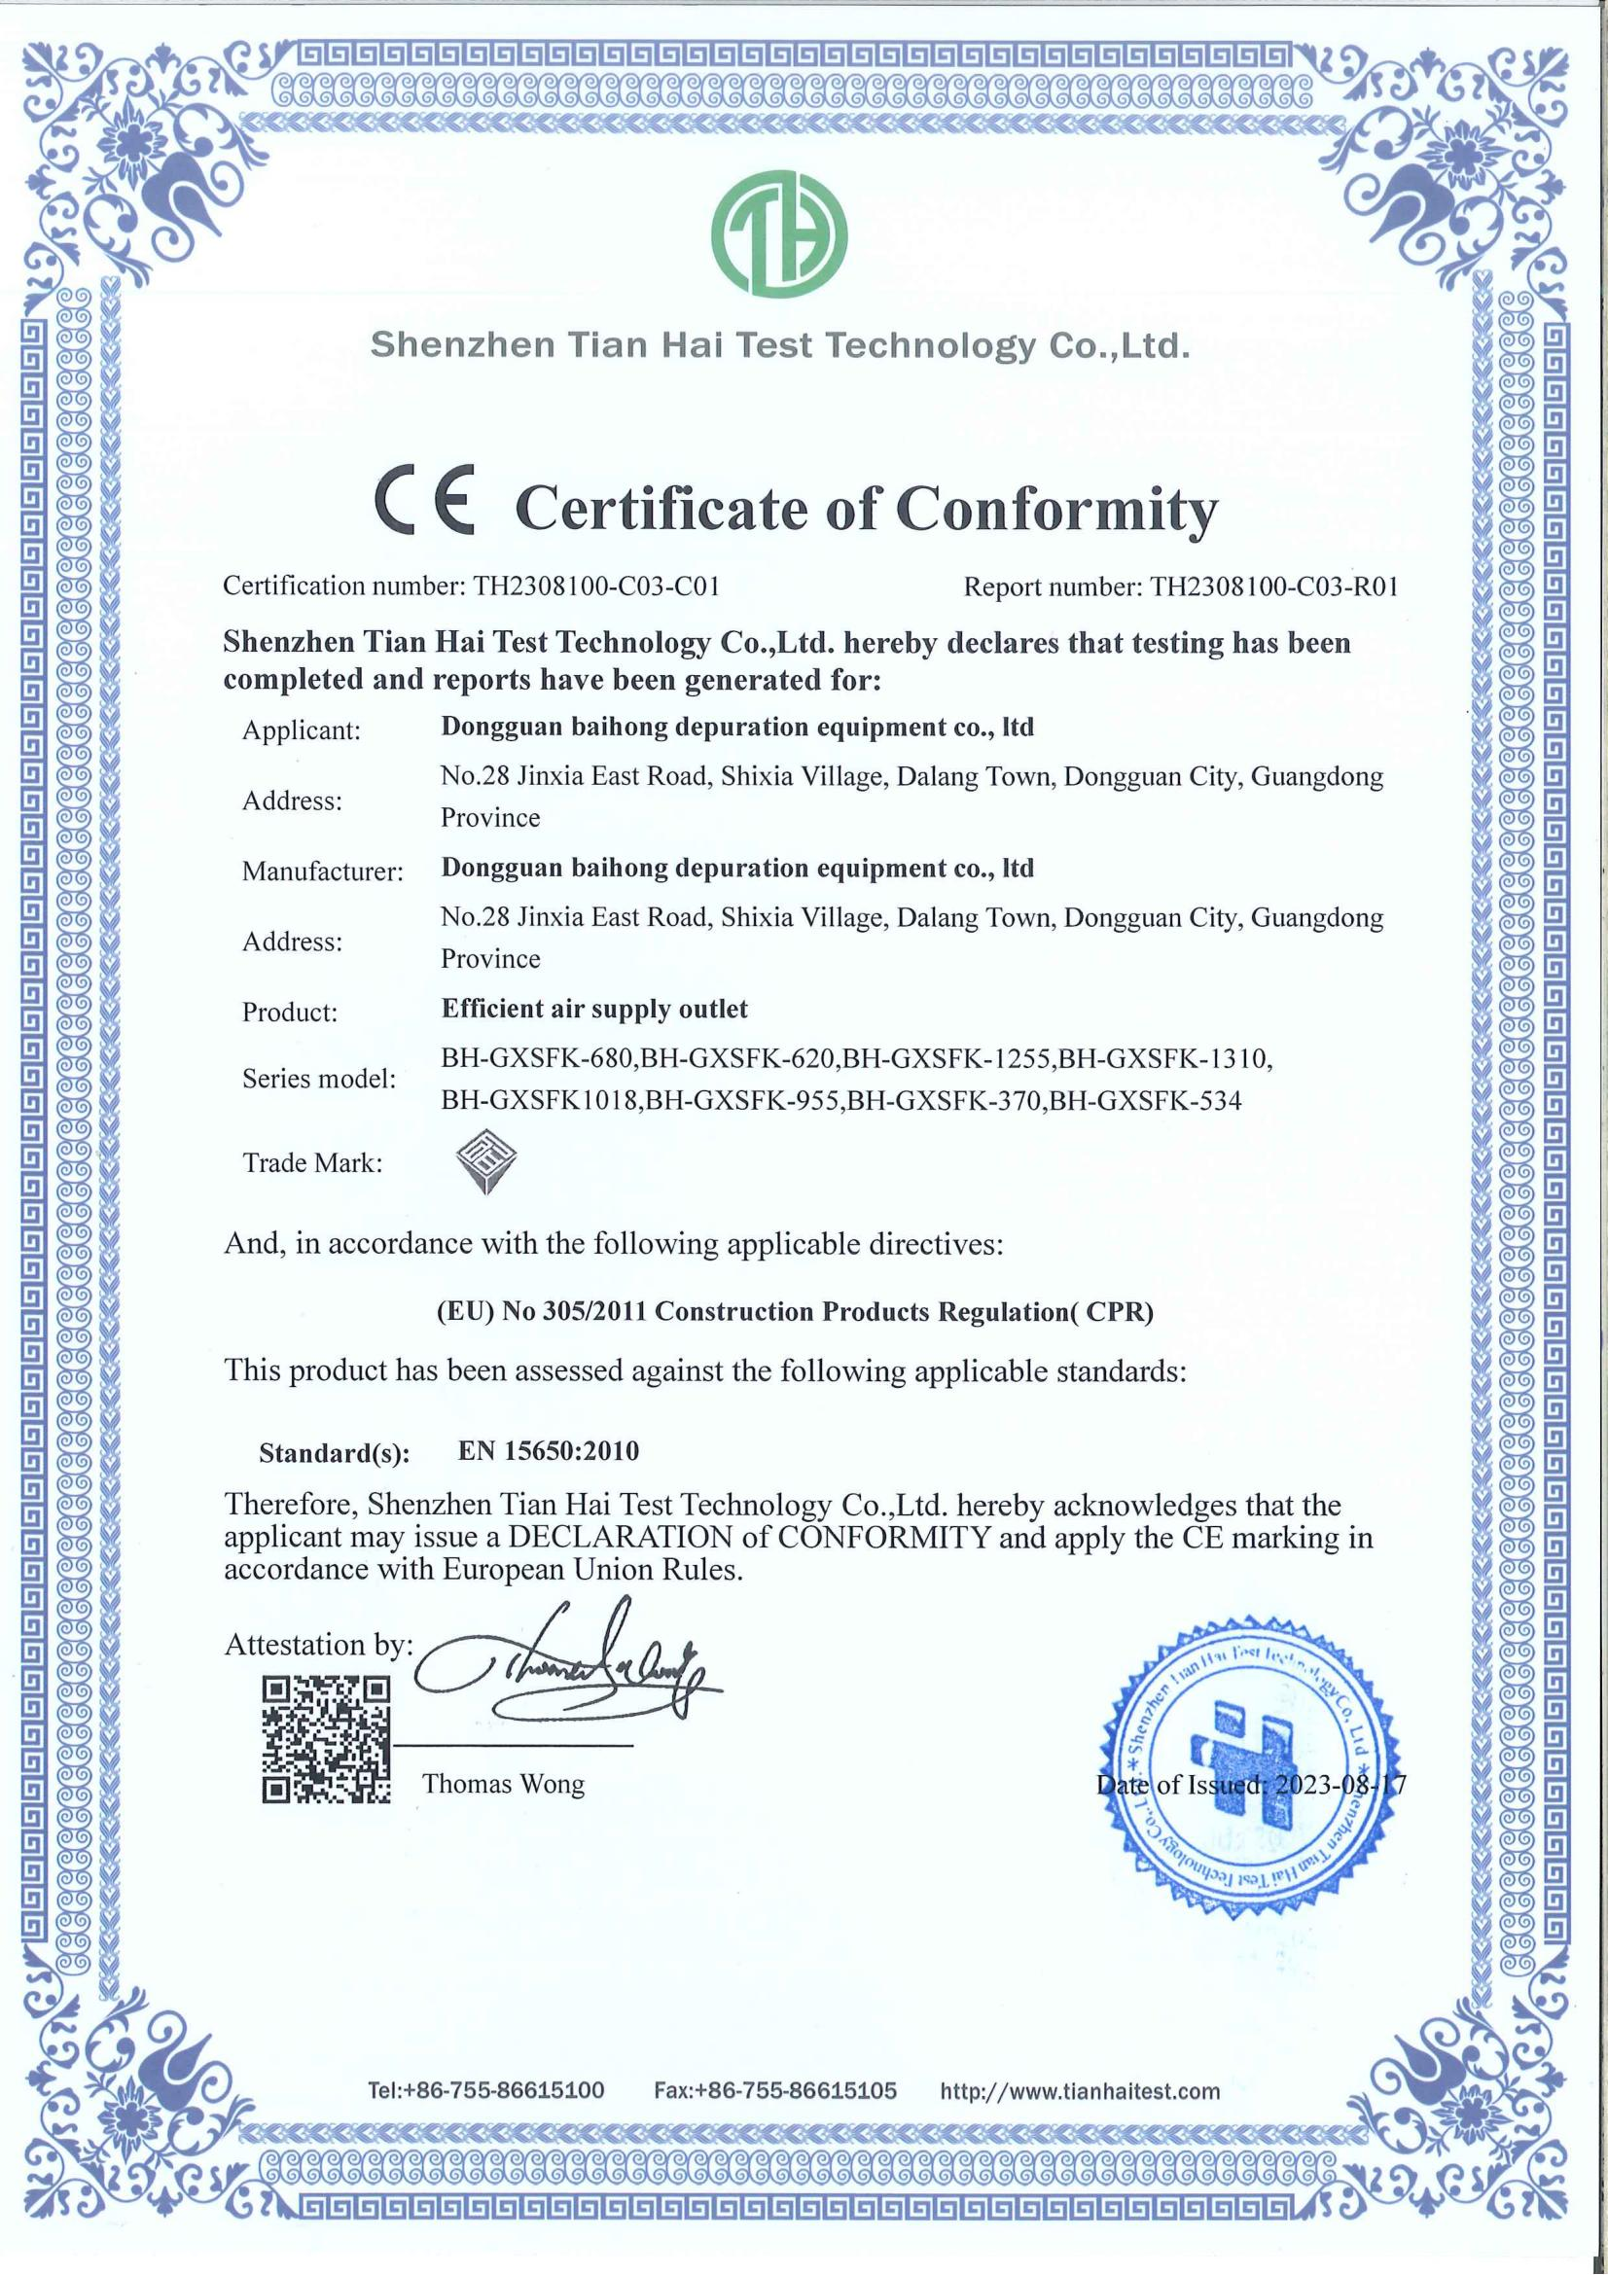
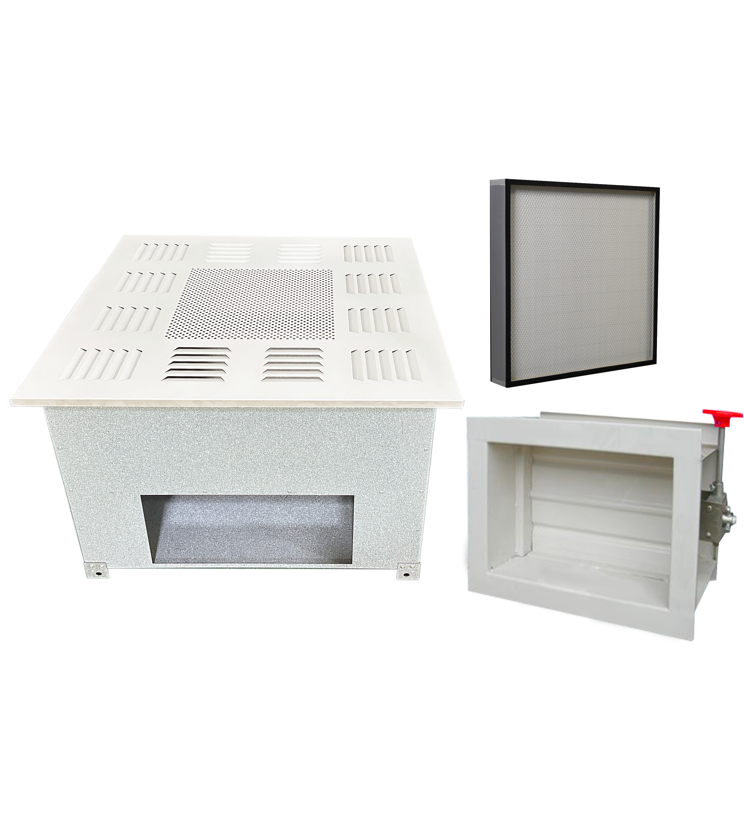
好品质 佰鸿造
Hao pin zhi Bai hong Zao
04
高效送风口CE认证合格书
Certificate of CE certification for efficient air supply outlet
型号：BH-GXSFK-680
箱体尺寸：680*680*380
过滤器尺寸：630*630*220
型号：BH-GXSFK-620
箱体尺寸：W620*D620*H400
过滤器尺寸：W570*D570*H180
型号： BH-GXSFK-1255
箱体尺寸：1255*645*400
过滤器尺寸：1210*600*180
型号：BH-GXSFK-1310
箱体尺寸：1310*680*380
过滤器尺寸：1260*630*220
型号： BH-GXSFK1018
箱体尺寸：1018*534*380
过滤器尺寸：968*484*220
型号： BH-GXSFK-955
箱体尺寸：W955*D645*H380
过滤器尺寸：W905*D600*H180
型号： BH-GXSFK-370
箱体尺寸：370*370*380
过滤器尺寸：320*320*220
型号： BH-GXSFK-534
箱体尺寸：534*534*380
过滤器尺寸：484*484*220

Slide 7
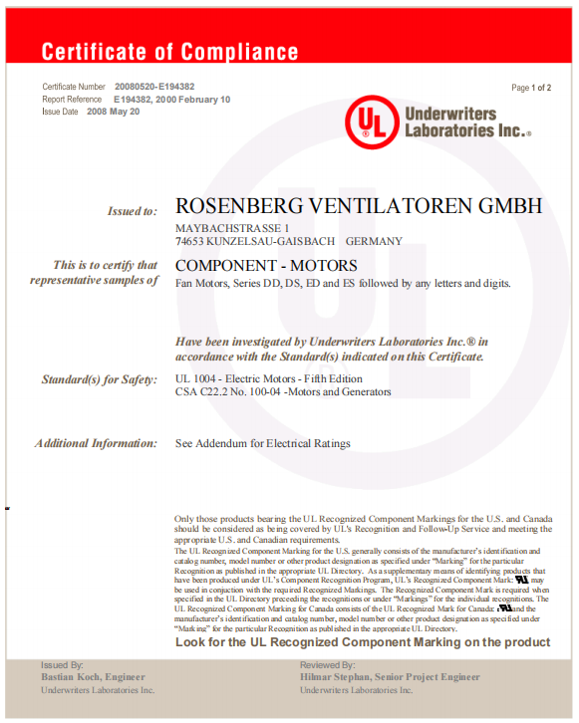
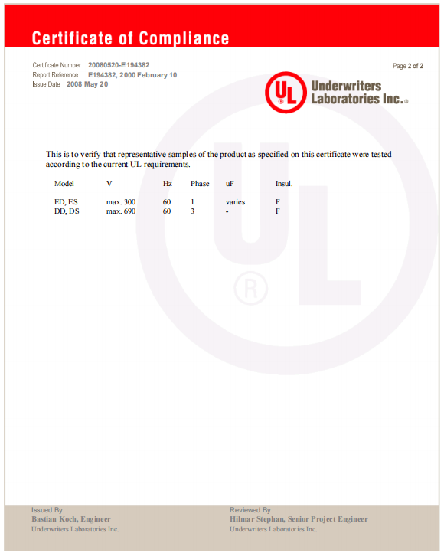
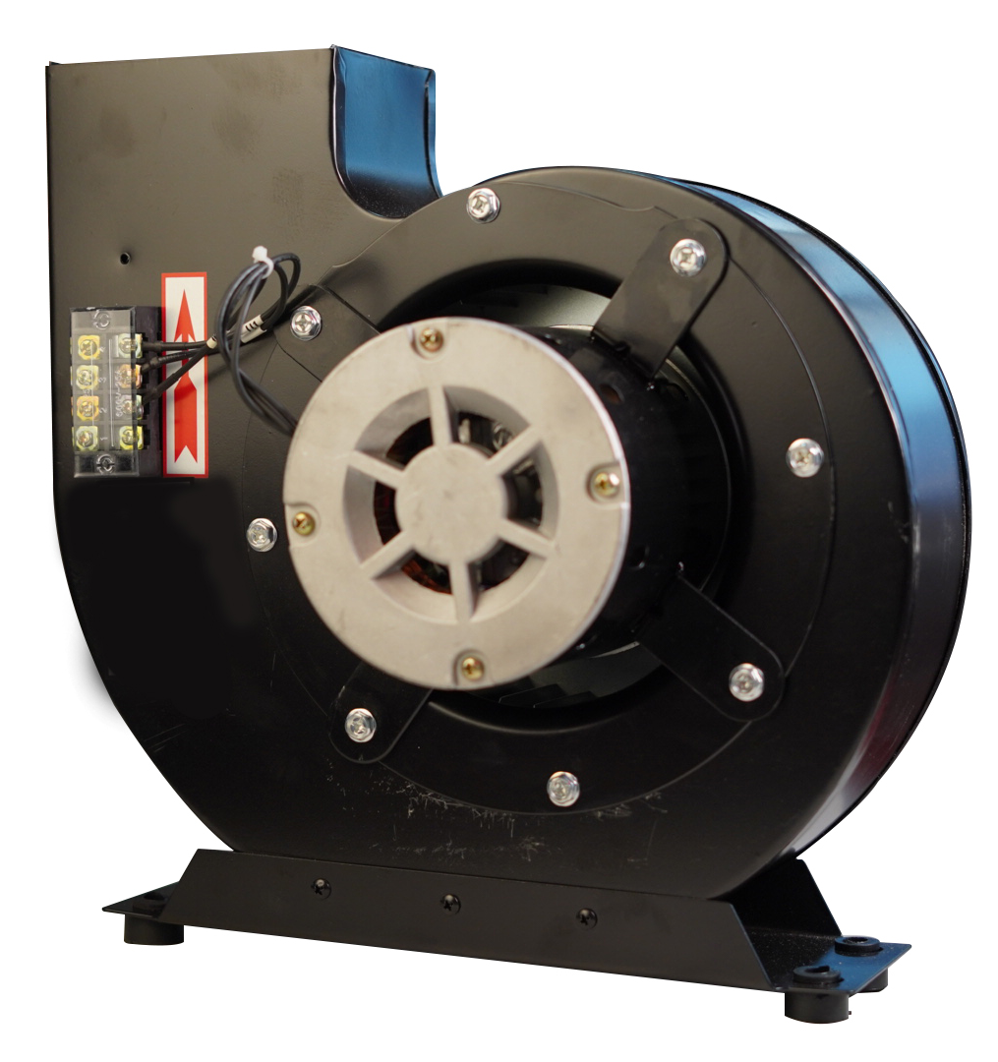
好品质 佰鸿造
Hao pin zhi Bai hong Zao
05
风机UL认证
UL certification of fan

Slide 8
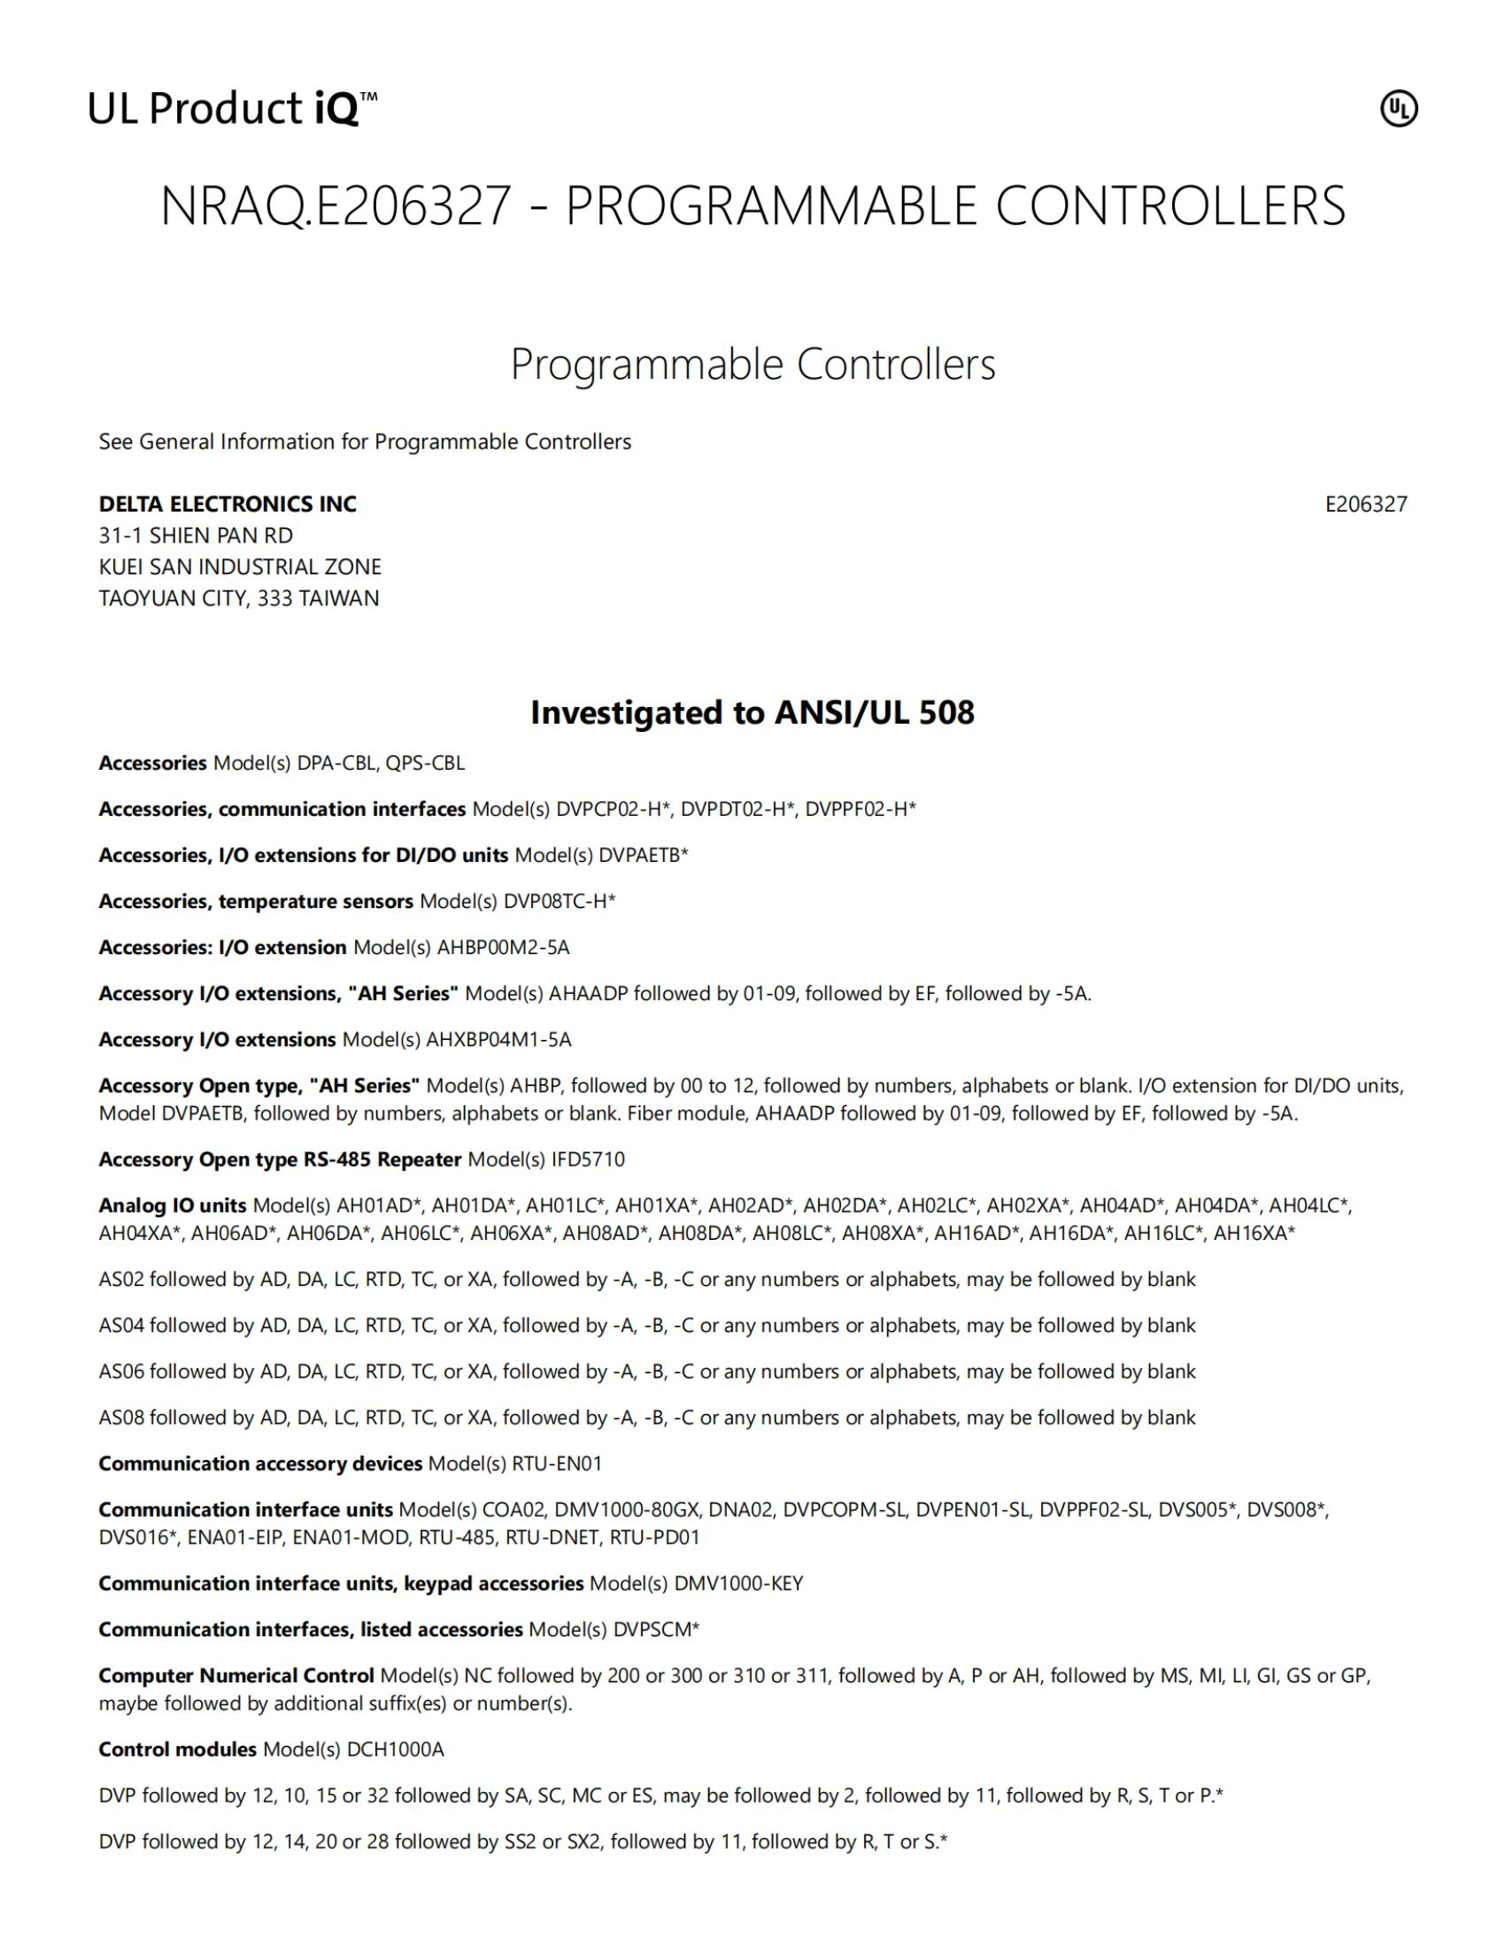
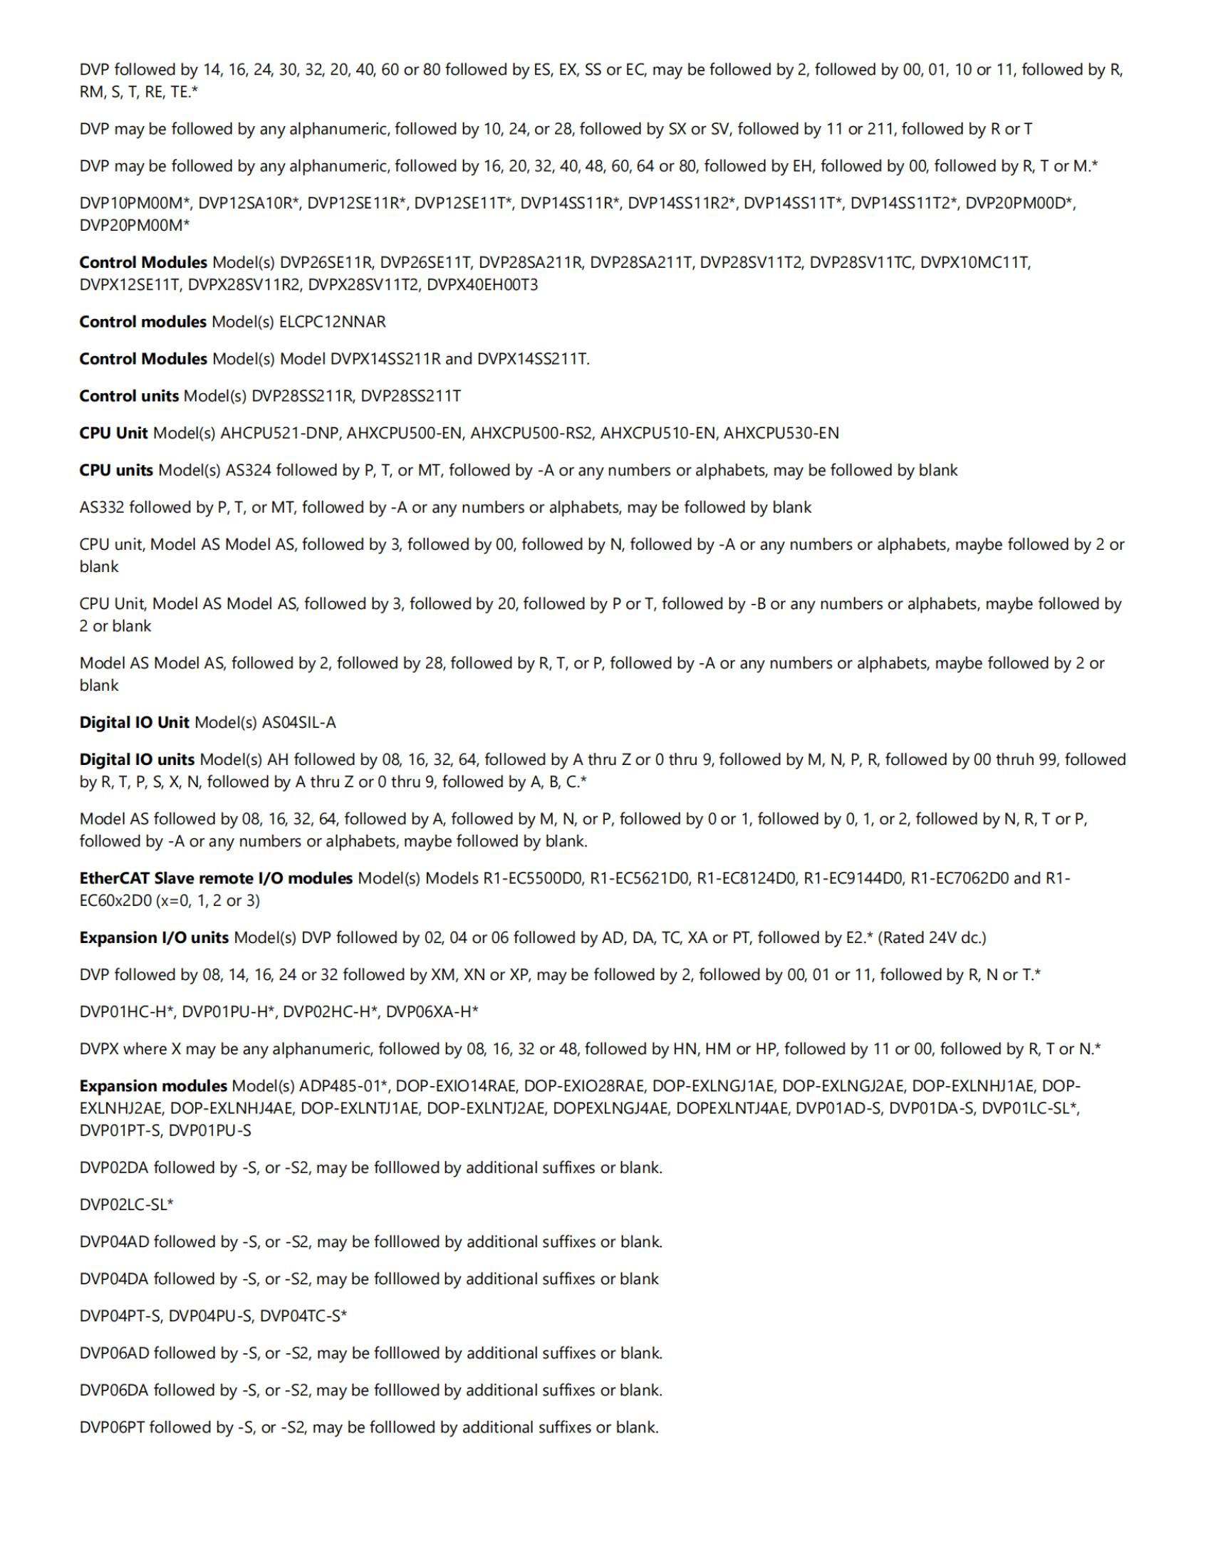
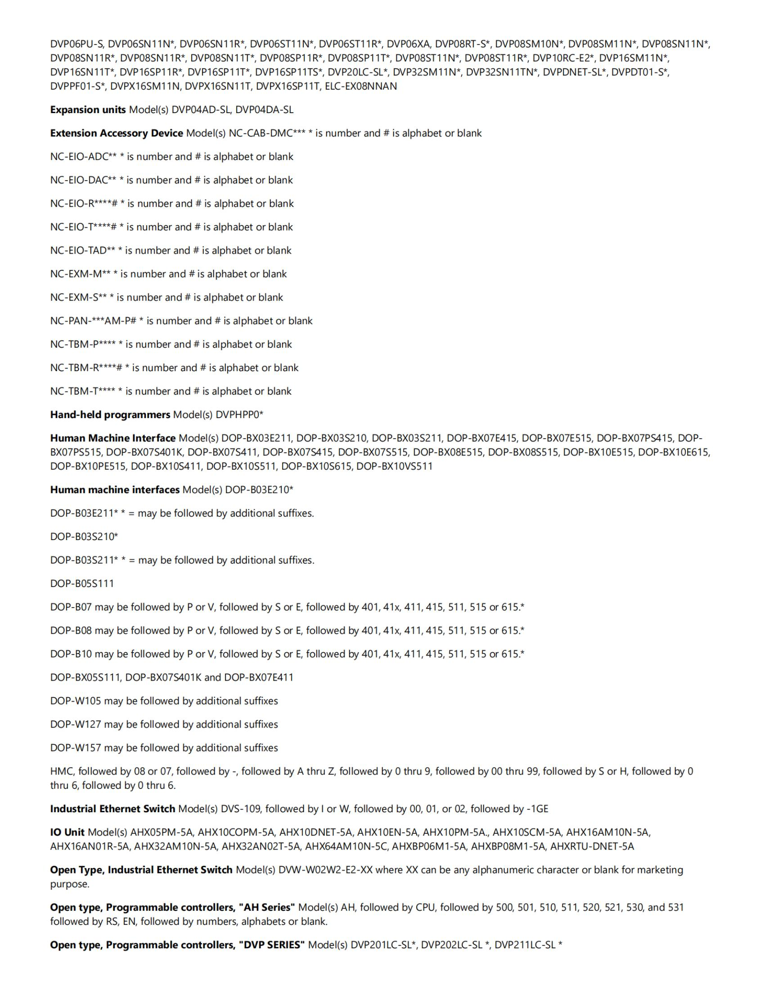
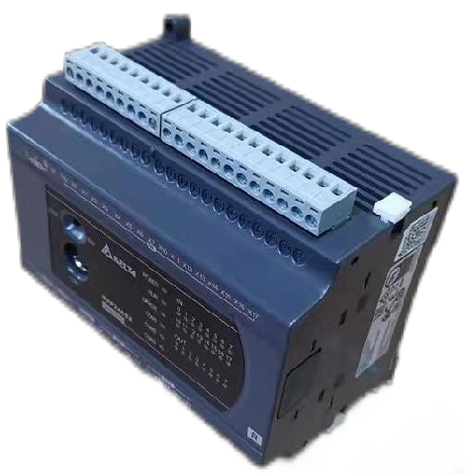
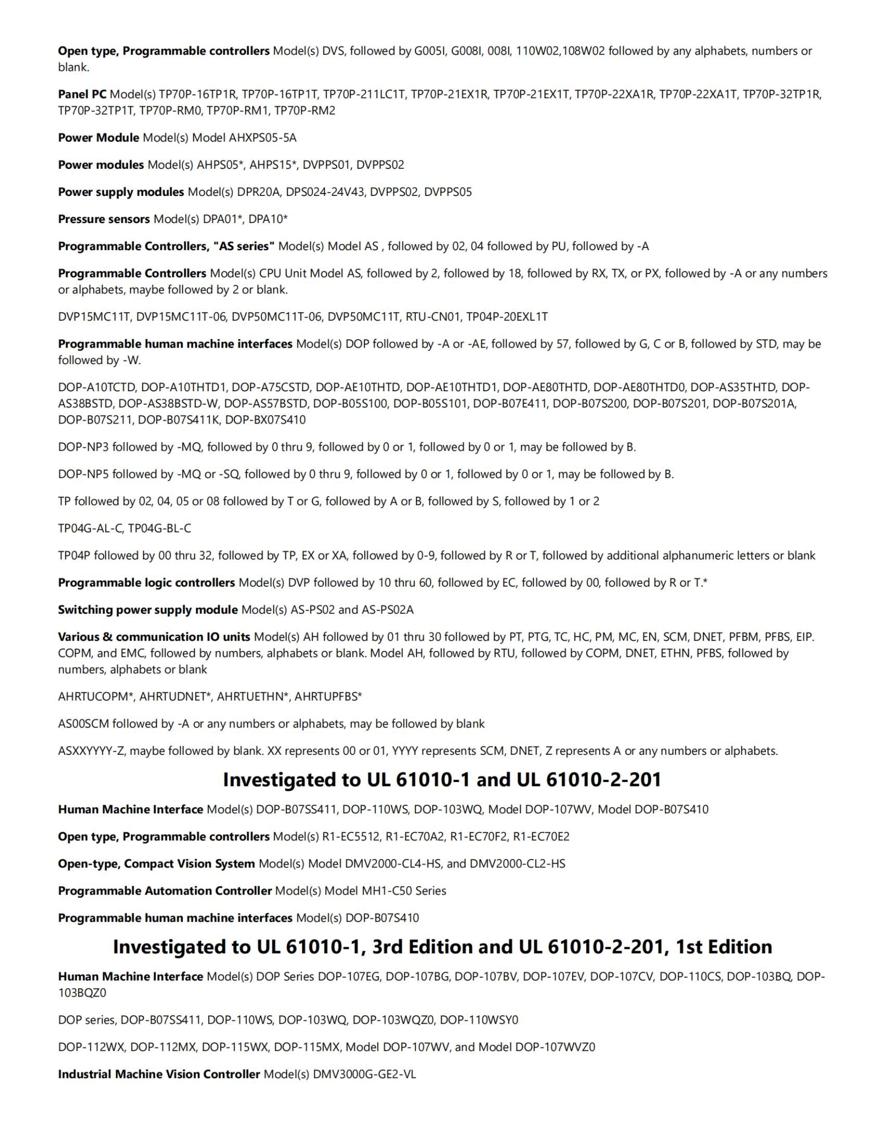
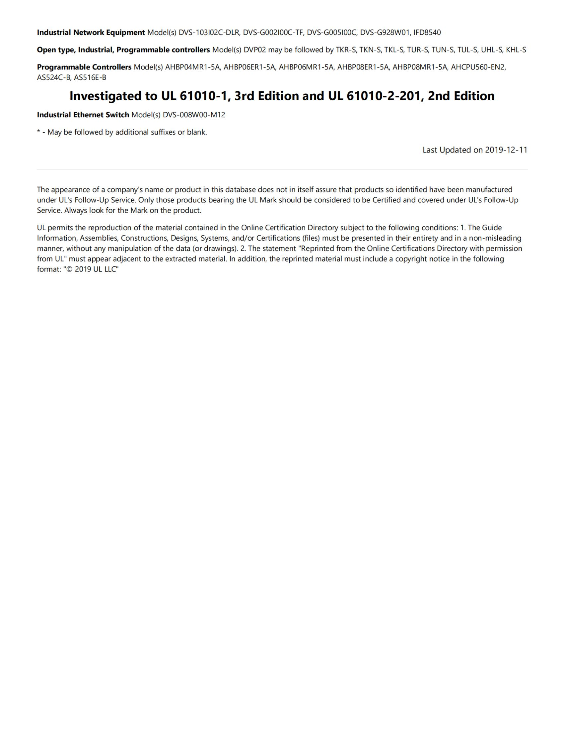
好品质 佰鸿造
Hao pin zhi Bai hong Zao
06
风淋室货淋室PLc控制器
Air shower room cargo shower room PLc controller

Slide 9
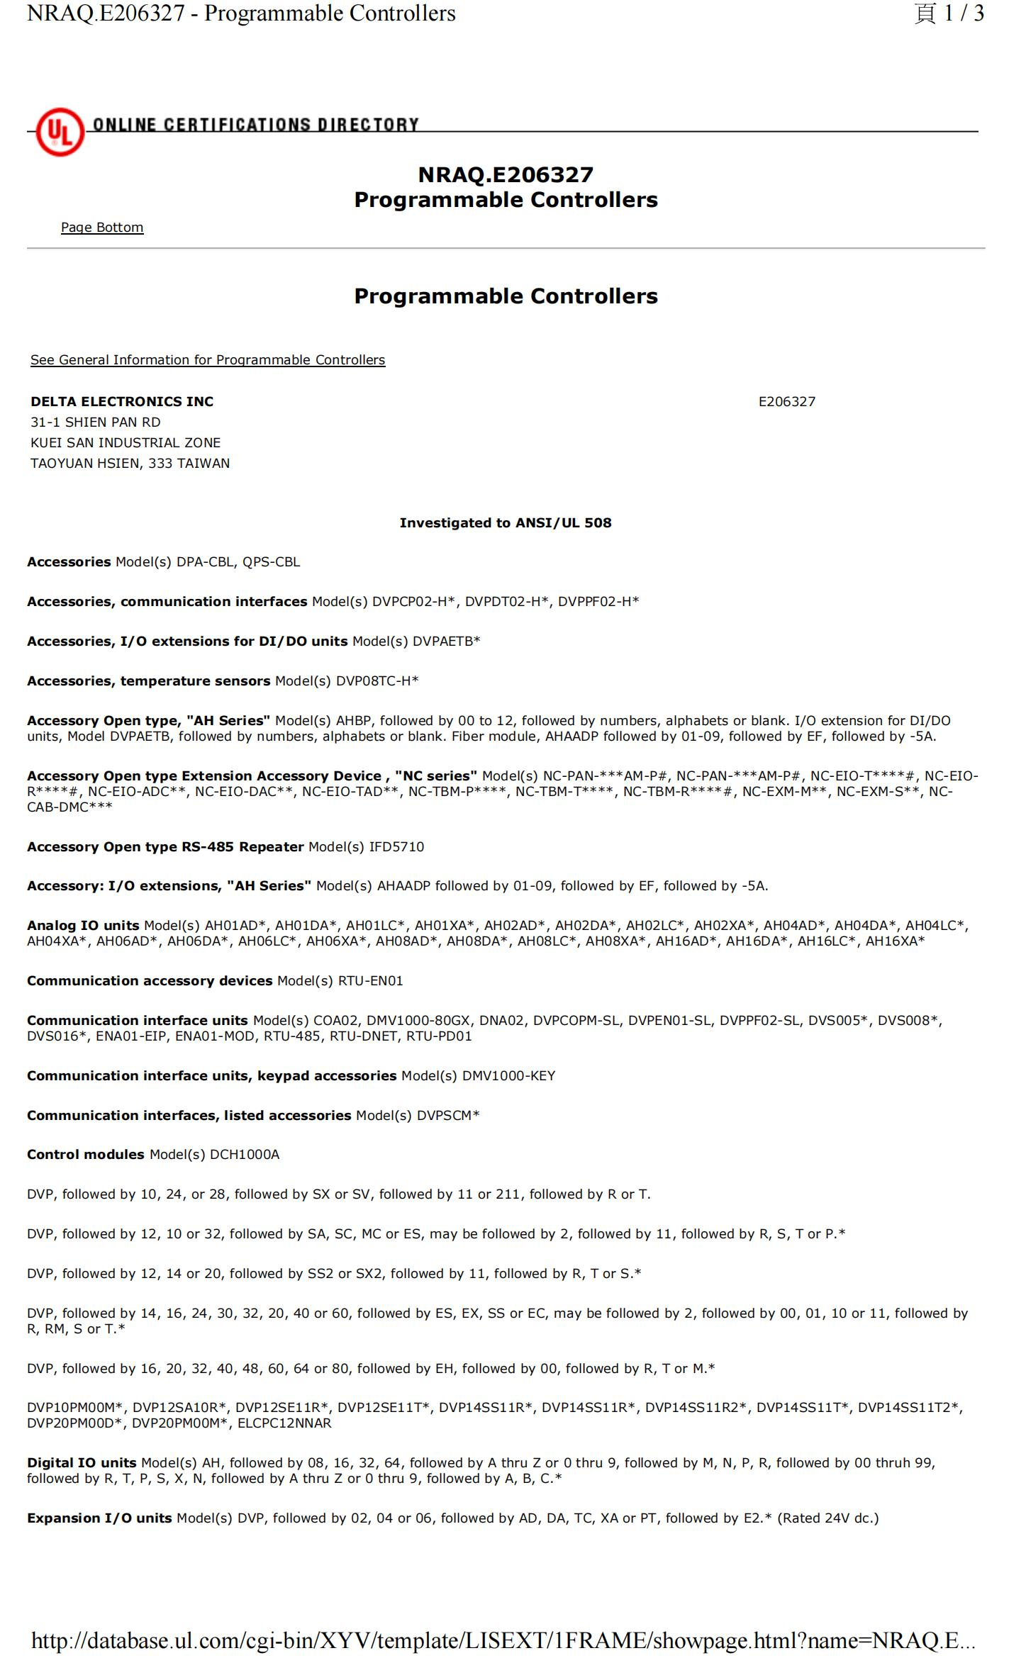
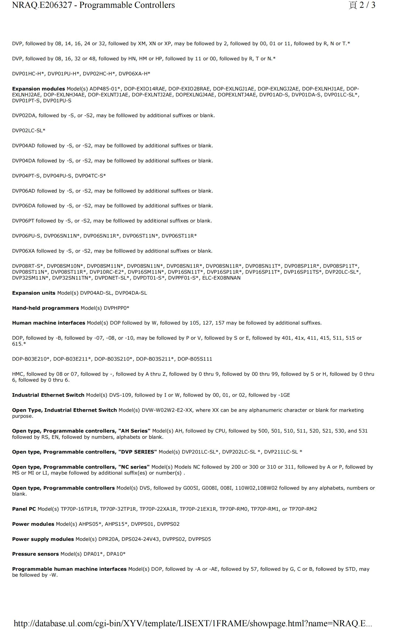
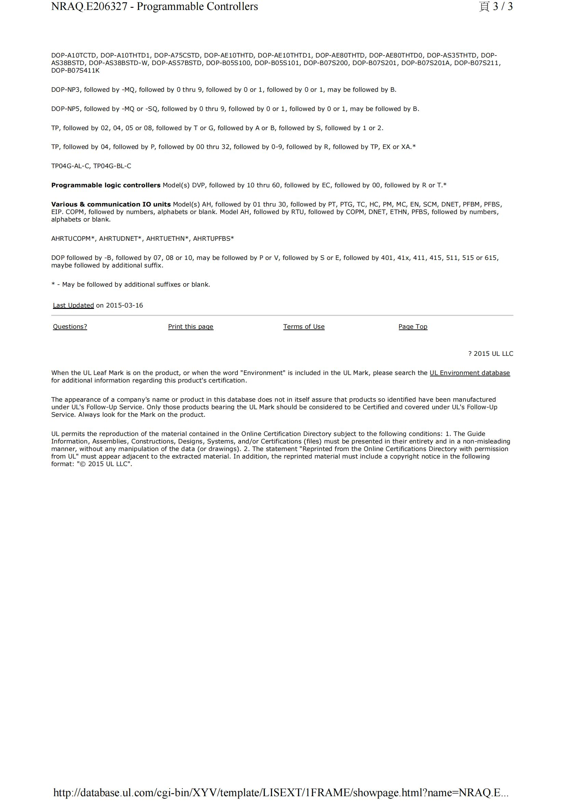
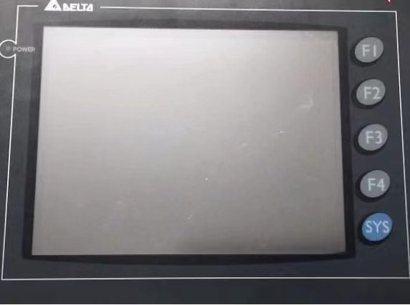
好品质 佰鸿造
Hao pin zhi Bai hong Zao
07
风淋室货淋室控制屏
Air shower room cargo shower room control screen

Slide 10
感谢您的观看
好品质 佰鸿造
Hao pin zhi Bai hong Zao
T H A N K S F O R W A T C H I G .
东莞市佰鸿净化设备有限公司
Dongguan Baihong Purification Equipment Co., Ltd
地址：广东东莞市大朗镇石厦村金厦东路28号
Address: No. 28 Jinxia East Road, Shixia Village, Dalang Town, Dongguan City, Guangdong Province
服务热线：0769-81293773 邮箱：BH81293773@163.com 网址：www.baihong666.com
Service hotline: 0769-81293773 Email: BH81293773@163.com website: www.baihong666.com

